Slide 1
Calorimetry
Unit 5
Matter Undergo Changes

Slide 2
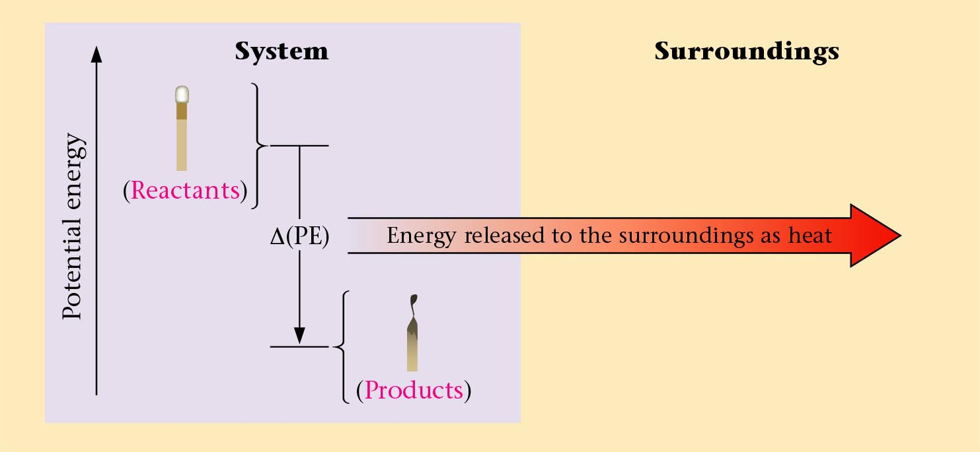

Burning of a Match
System
Surroundings
(Reactants)
Potential energy
Δ(PE)
Energy released to the surrounding as heat
(Products)
Zumdahl, Zumdahl, DeCoste, World of Chemistry 2002, page 293

Slide 3
Conservation of Energy in a Chemical Reaction
In this example, the energy of the reactants and products increases,
while the energy of the surroundings decreases.
In every case, however, the total energy does not change.
Endothermic Reaction
Reactant + Energy Product
Surroundings
Surroundings
System
Energy
System
Before
reaction
After
reaction
Myers, Oldham, Tocci, Chemistry, 2004, page 41

Slide 4
Conservation of Energy in a Chemical Reaction
In this example, the energy of the reactants and products decreases,
while the energy of the surroundings increases.
In every case, however, the total energy does not change.
Exothermic Reaction
Reactant Product + Energy
Surroundings
Surroundings
System
Energy
System
Before
reaction
After
reaction
Myers, Oldham, Tocci, Chemistry, 2004, page 41

Slide 5
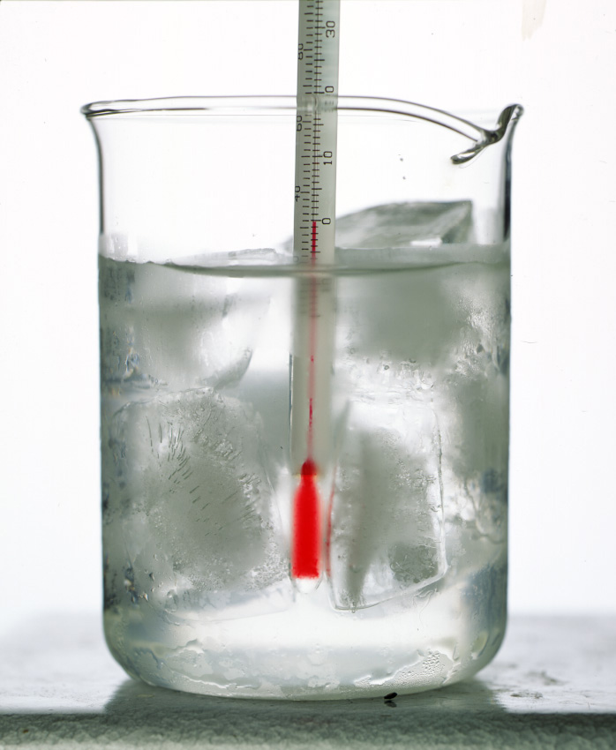
Direction of Heat Flow
Surroundings
ENDOthermic
q_{sys} > 0
EXOthermic
q_{sys} < 0
System
H₂O(s) + heat → H₂O(l)
H₂O(l) → H₂O(s) + heat
melting
freezing
System
Kotz, Purcell, Chemistry & Chemical Reactivity 1991, page 207

Slide 6
Caloric Values
Food joules/grams calories/gram Calories/gram
Protein 17 000 4000 4
Fat 38 000 9000 9
Carbohydrates 17 000 4000 4
1calories = 4.184 joules
1000 calories = 1 Calorie
"science" "food"
Smoot, Smith, Price, Chemistry A Modern Course, 1990, page 51

Slide 7
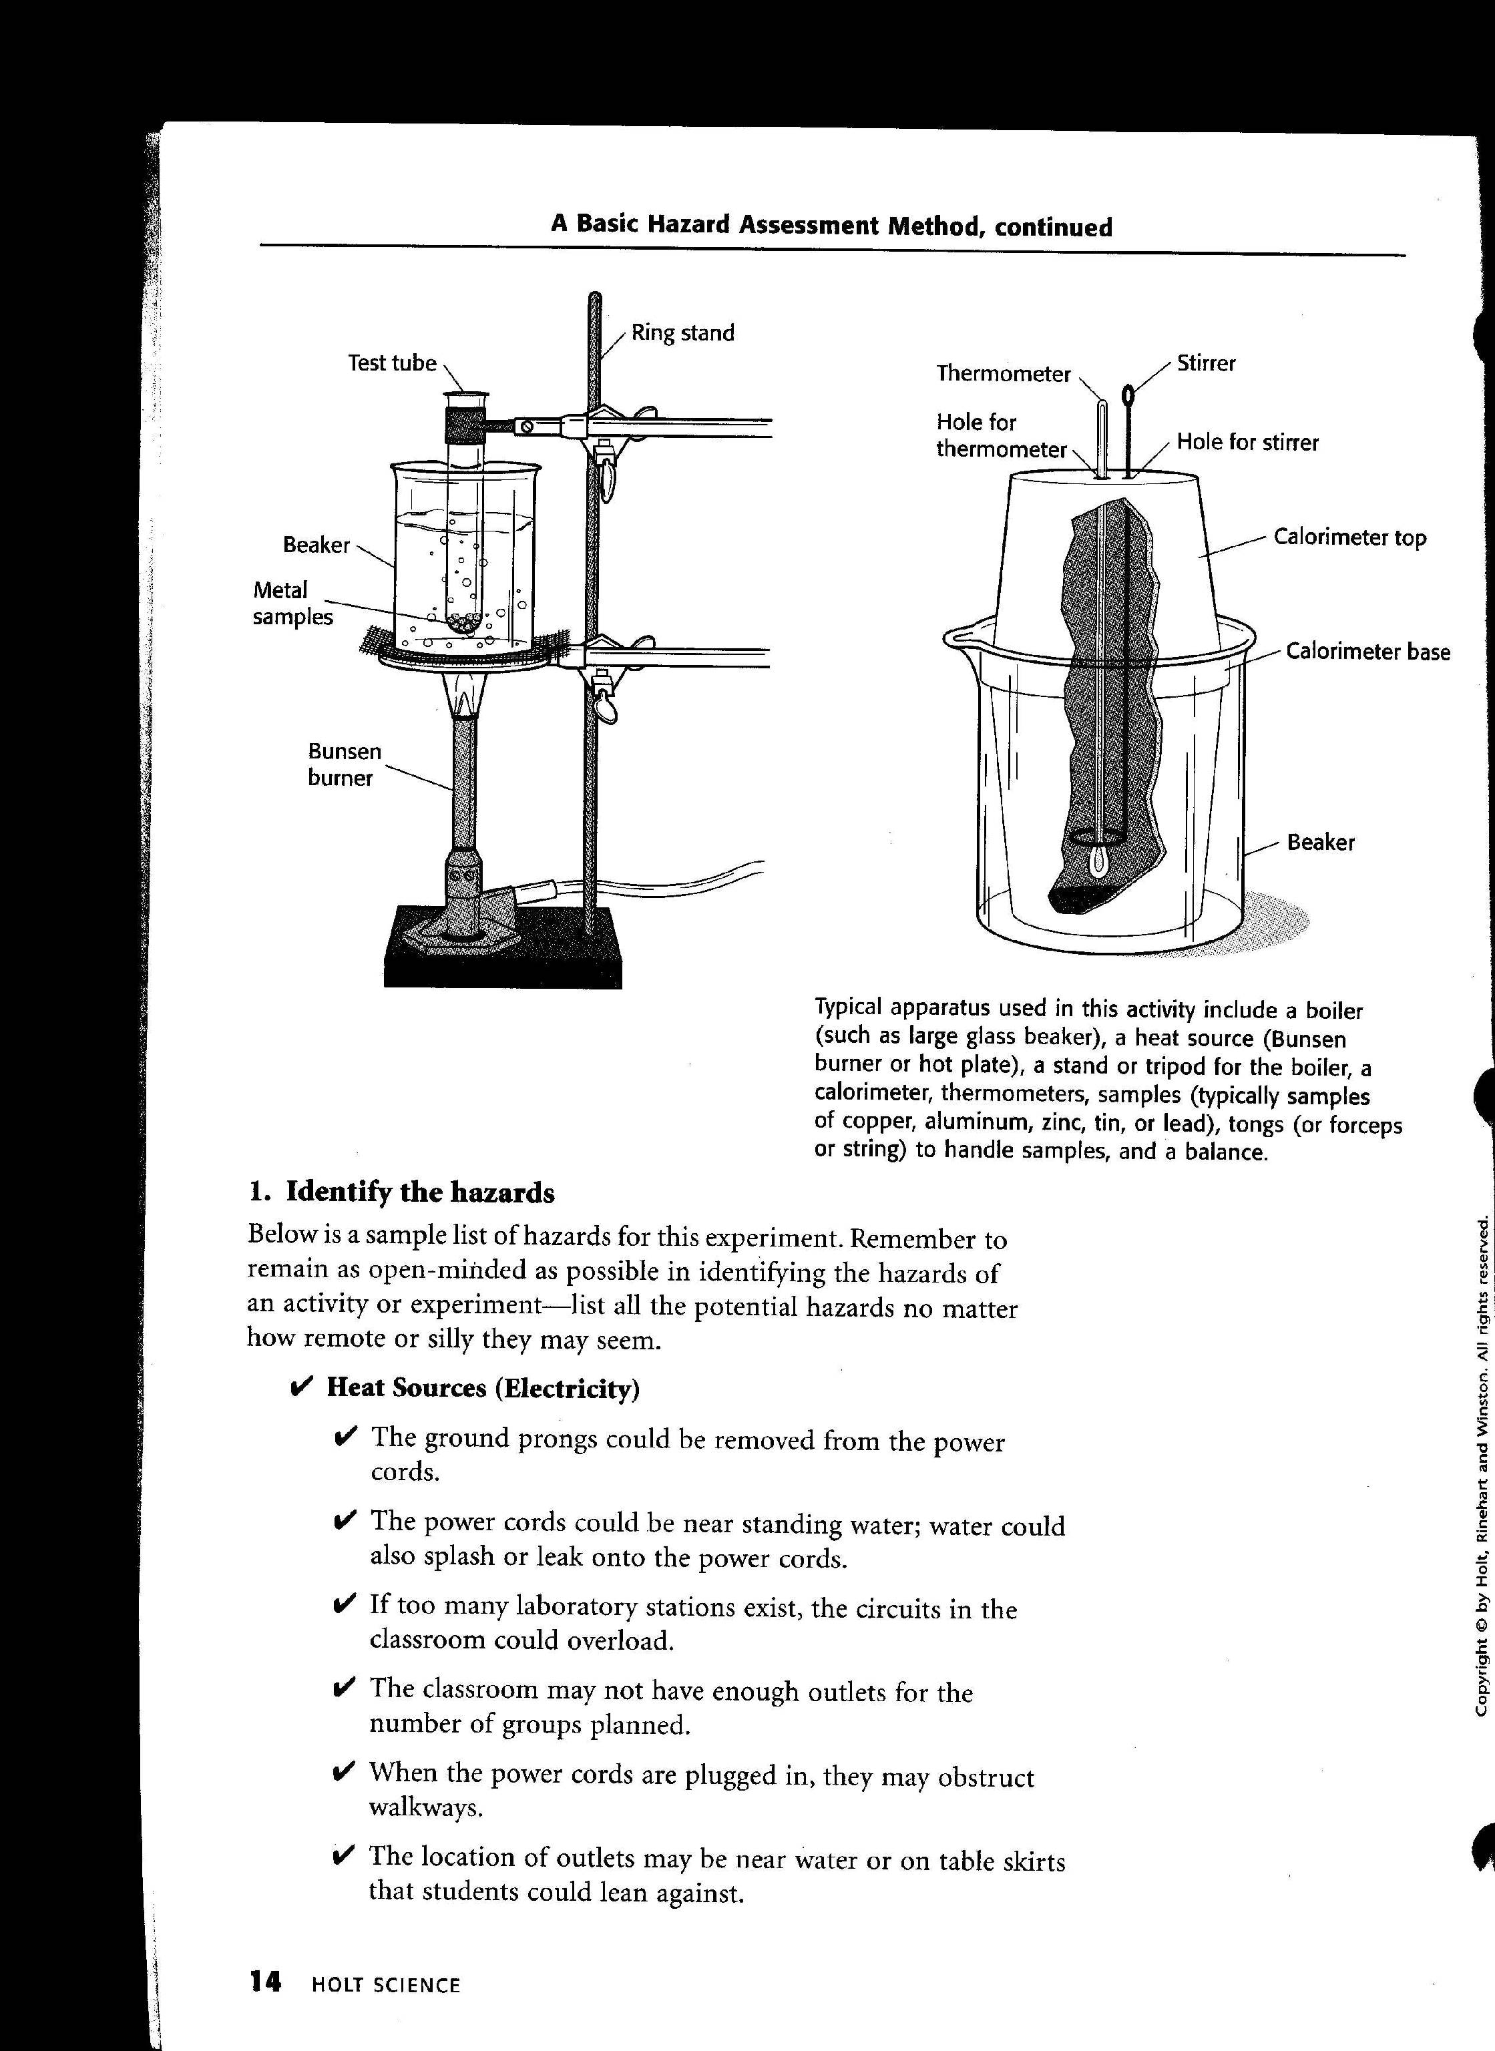
Experimental Determination of Specific Heat of a Metal
Typical apparatus used in this activity include a boiler (such as large glass beaker), a heat source (Bunsen burner or hot plate), a stand or tripod for
the boiler, a calorimeter, thermometers, samples (typically samples of copper, aluminum, zinc, tin, or lead), tongs (or forceps or string) to handle samples, and a balance.

Slide 8
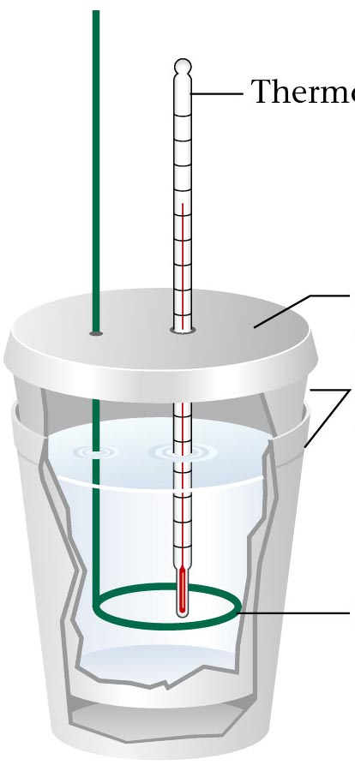
A Coffee Cup Calorimeter
Thermometer
Styrofoam
cover
Styrofoam
cups
Stirrer
Zumdahl, Zumdahl, DeCoste, World of Chemistry 2002, page 302

Slide 9
Bomb Calorimeter
thermometer
stirrer
full of water
ignition wire
steel “bomb”
sample

Slide 10
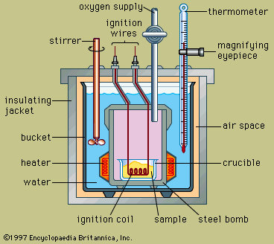
A Bomb Calorimeter
oxygen supply
thermometer
ignition
wires
stirrer
magnifying
eyepiece
insulating
jacket
air space
bucket
heater
crucible
water
ignition coil
sample
steel bomb
1997 Encyclopedia Britanica, Inc.

Slide 11
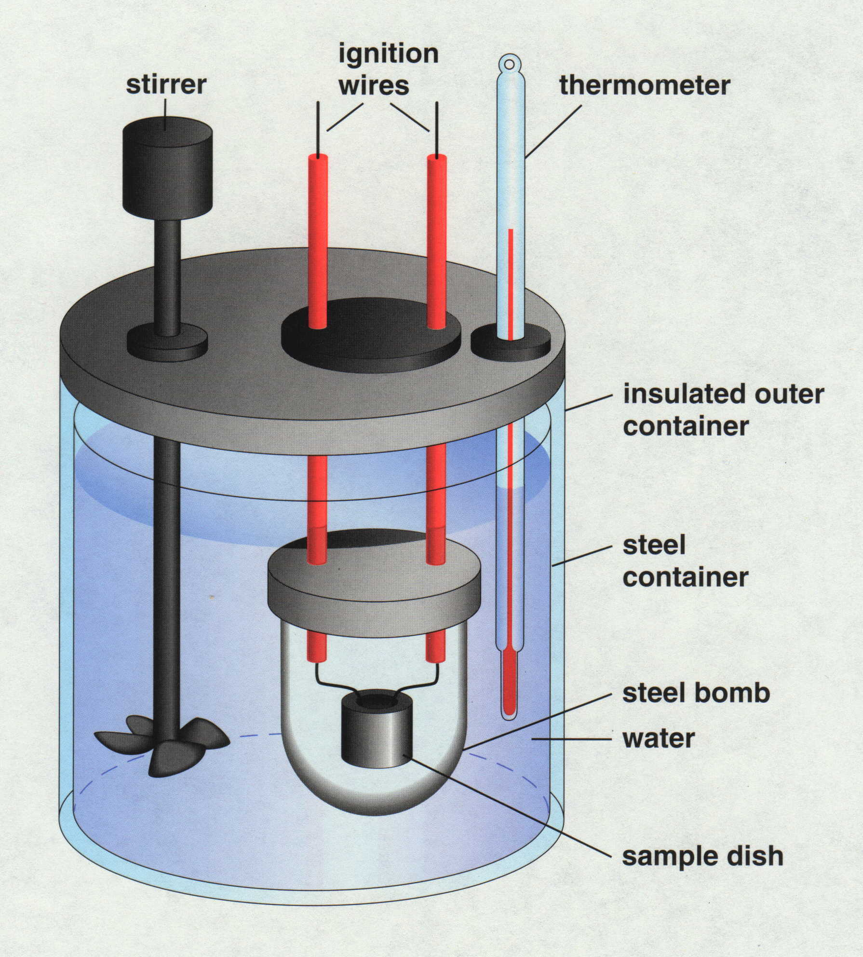
A Bomb Calorimeter

Slide 12
140
Gas - KE ↑
120
100
80
Boiling - PE ↑
60
40
Temperature (ºC)
Liquid - KE ↑
20
0
-20
Melting - PE ↑
-40
-60
Solid - KE ↑
-80
-100
Time

Slide 13
Heating Curves
140
Gas - KE ↑
120
100
80
Boiling - PE ↑
60
40
Temperature (ºC)
Liquid - KE ↑
20
0
-20
Melting - PE ↑
-40
-60
Solid - KE ↑
-80
-100
Time

Slide 14
Heating Curves
Temperature Change
  change in KE (molecular motion)
  depends on heat capacity
Heat Capacity
  energy required to raise the temp of 1 gram of a substance by 1°C
  “Volcano” clip -
  water has a very high heat capacity
Courtesy Christy Johannesson www.nisd.net/communicationsarts/pages/chem

Slide 15
Heating Curves
Phase Change
  change in PE (molecular arrangement)
  temp remains constant
Heat of Fusion (ΔH_{fus})
  energy required to melt 1 gram of a substance at its m.p.
Courtesy Christy Johannesson www.nisd.net/communicationsarts/pages/chem

Slide 16
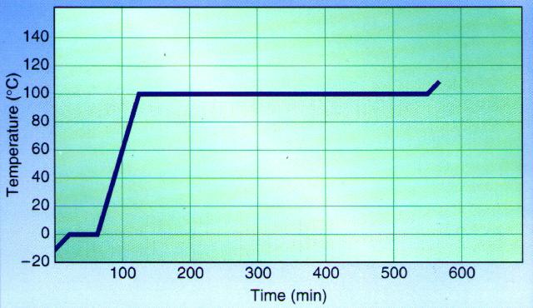
Heating Curves
Heat of Vaporization (ΔH_{vap})
  energy required to boil 1 gram of a substance at its b.p.
  usually larger than ΔH_{fus}…why?
EX: sweating, steam burns, the drinking bird
Courtesy Christy Johannesson www.nisd.net/communicationsarts/pages/chem

Slide 17
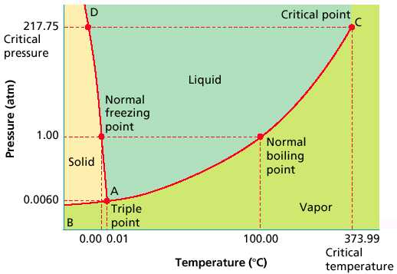
Phase Diagrams
Show the phases of a substance at different temps and pressures.”
Courtesy Christy Johannesson www.nisd.net/communicationsarts/pages/chem

Slide 18
Humor
A small piece of ice which lived in a test tube fell in love with a Bunsen burner.
“Bunsen! My flame! I melt whenever I see you” said the ice.
The Bunsen burner replied” “It’s just a phase you’re going through”.

Slide 19
Heating Curve for Water
(Phase Diagram)
140
120
100
80
60
40
20
0
-20
-40
-60
-80
-100
Heat = m x C_{vap}
F
C_{v} = 2256 J/g
BP
Heat = m x C_{fus}
D
E
C_{f} = 333 J/g
Heat = m x ΔT x C_{p, gas}
C_{p (steam)} = 2.042 J/gºC
Heat = m x ΔT x C_{p, liquid}
Temperature (ºC)
C_{p} = 4.184 J/gºC
MP
B
C
Heat = m x ΔT x C_{p, solid}
A → B warm ice
B → C melt ice (solid → liquid)
C → D warm water
D → E boil water (liquid → gas)
E → D condense steam (gas → liquid)
E → F superheat steam
C_{p (ice)} = 2.077 J/gºC
A
Heat

Slide 20
Calculating Energy Changes - Heating Curve for Water
140
ΔH = mol x ΔH_{vap}
120
ΔH = mol x ΔH_{fus}
100
80
60
Heat = mass x Δt x C_{p, gas}
40
Temperature (ºC)
20
Heat = mass x Δt x C_{p, liquid}
0
-20
-40
-60
-80
Heat = mass x Δt x C_{p, solid}
-100
Time

Slide 21
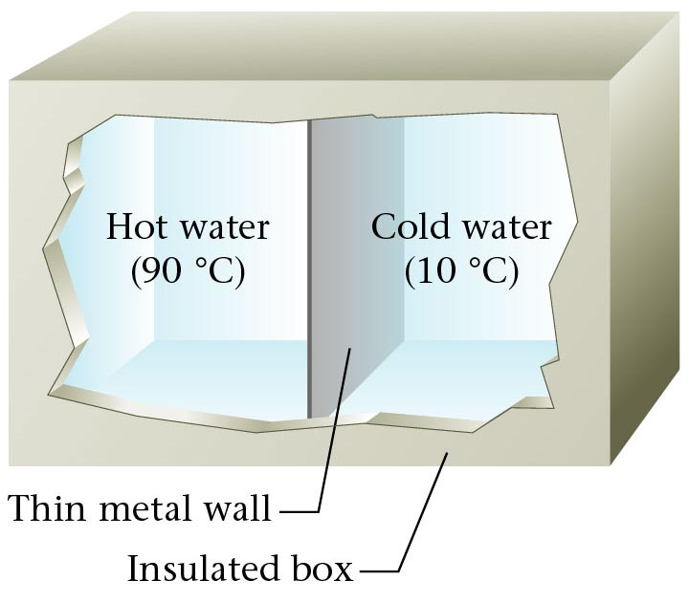
Equal Masses of Hot and Cold Water
Thin metal wall
Insulated box
Zumdahl, Zumdahl, DeCoste, World of Chemistry 2002, page 291

Slide 22
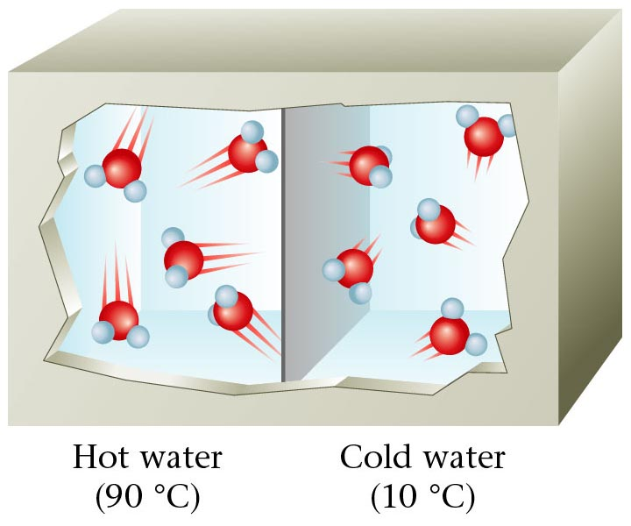
Water Molecules in Hot and Cold Water
Hot water Cold Water
90 ºC 10 ºC
Zumdahl, Zumdahl, DeCoste, World of Chemistry 2002, page 291

Slide 23
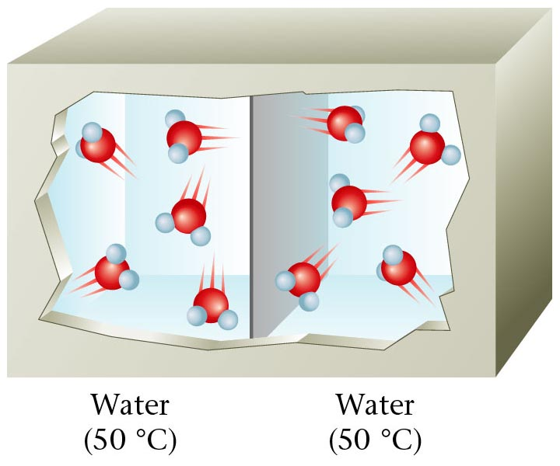
Water Molecules in the same temperature water
Zumdahl, Zumdahl, DeCoste, World of Chemistry 2002, page 291

Slide 24
Heat Transfer
Surroundings
Final
Temperature
Block “A”
Block “B”
SYSTEM
20 g (40ºC)
20 g (20ºC)
30ºC
Al
Al
m = 20 g
T = 40ºC
m = 20 g
T = 20ºC
What will be the final temperature
of the system ?
a) 60ºC b) 30ºC c) 20ºC d) ?
Assume NO heat energy is “lost” to the surroundings from the system.

Slide 25
Heat Transfer
?
Surroundings
Final
Temperature
Block “A”
Block “B”
SYSTEM
20 g (40ºC)
20 g (20ºC)
30.0ºC
20 g (40ºC)
10 g (20ºC)
33.3ºC
Al
Al
m = 20 g
T = 40ºC
m = 10 g
T = 20ºC
What will be the final temperature
of the system ?
a) 60ºC b) 30ºC c) 20ºC d) ?
Assume NO heat energy is “lost” to the surroundings from the system.

Slide 26
Heat Transfer
Surroundings
Final
Temperature
Block “A”
Block “B”
SYSTEM
20 g (40ºC)
20 g (20ºC)
30.0ºC
20 g (40ºC)
10 g (20ºC)
33.3ºC
20 g (20ºC)
10 g (40ºC)
26.7ºC
Al
Al
m = 20 g
T = 20ºC
m = 10 g
T = 40ºC
Assume NO heat energy is “lost” to the surroundings from the system.

Slide 27
Heat Transfer
Surroundings
Final
Temperature
Block “A”
Block “B”
SYSTEM
20 g (40ºC)
20 g (20ºC)
30.0ºC
20 g (40ºC)
10 g (20ºC)
33.3ºC
20 g (20ºC)
10 g (40ºC)
26.7ºC
H₂O
Ag
m = 75 g
T = 25ºC
m = 30 g
T = 100ºC
Real Final Temperature = 26.6ºC
Why?
We’ve been assuming ALL materials
transfer heat equally well.

Slide 28
Specific Heat
Water and silver do not transfer heat equally well.
Water has a specific heat C_{p} = 4.184 J/gºC
Silver has a specific heat C_{p} = 0.235 J/gºC
What does that mean?
It requires 4.184 Joules of energy to heat 1 gram of water 1ºC
and only 0.235 Joules of energy to heat 1 gram of silver 1ºC.
Law of Conservation of Energy…
In our situation (silver is “hot” and water is “cold”)…
this means water heats up slowly and requires a lot of energy
whereas silver will cool off quickly and not release much energy.
Lets look at the math!

Slide 29
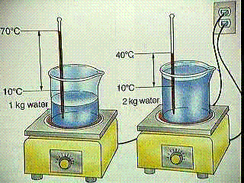
Specific Heat
The amount of heat required to raise the temperature of one gram of substance by one degree Celsius.

Slide 30
Calculations involving Specific Heat
OR
c_{p} = Specific Heat
q = Heat lost or gained
ΔT = Temperature change
m = Mass

Slide 31
Table of Specific Heats
Specific Heats of Some Common
Substances at 298.15 K
Substance Specific heat J/(g.K)
Water (l) 4.18
Water (s) 2.06
Water (g) 1.87
Ammonia (g) 2.09
Benzene (l) 1.74
Ethanol (l) 2.44
Ethanol (g) 1.42
Aluminum (s) 0.897
Calcium (s) 0.647
Carbon, graphite (s) 0.709
Copper (s) 0.385
Gold (s) 0.129
Iron (s) 0.449
Mercury (l) 0.140
Lead (s) 0.129

Slide 32
Latent Heat of Phase Change
Molar Heat of Fusion
The energy that must be absorbed in order to convert one mole of solid to liquid at its melting point.
The energy that must be removed in order to convert one mole of liquid to solid at its freezing point.

Slide 33
Latent Heat of Phase Change #2
Molar Heat of Vaporization
The energy that must be absorbed in order to convert one mole of liquid to gas at its boiling point.
The energy that must be removed in order to convert one mole of gas to liquid at its condensation point.

Slide 34
Latent Heat – Sample Problem
Problem: The molar heat of fusion of water is 6.009 kJ/mol. How much energy is needed to convert 60 grams of ice at 0°C to liquid water at 0°C?
Mass
of ice
Molar
Mass of
water
Heat
of
fusion

Slide 35
Heat of Reaction
The amount of heat released or absorbed during a chemical reaction.
Endothermic:
Reactions in which energy is absorbed as the reaction proceeds.
Exothermic:
Reactions in which energy is released as the reaction proceeds.

Slide 36
Calorimetry
“loses” heat
Surroundings
SYSTEM
T_{final} = 26.6ºC
H₂O
Ag
m = 75 g
T = 25ºC
m = 30 g
T = 100ºC

Slide 37
Calorimetry
Surroundings
SYSTEM
H₂O
Ag
m = 75 g
T = 25ºC
m = 30 g
T = 100ºC

Slide 38
1 BTU (British Thermal Unit) – amount of heat needed to raise 1 pound of water 1ºF.
1 calorie - amount of heat needed to raise 1 gram of water 1ºC
1 Calorie = 1000 calories
“food” = “science”
Candy bar
300 Calories = 300,000 calories
English
Joules
1 calorie = 4.184 Joules
Metric = _______

Slide 39
140
ΔH = mol x ΔH_{fus}
ΔH = mol x ΔH_{vap}
120
100
80
60
Heat = mass x Δt x C_{p, gas}
40
Temperature (ºC)
20
Heat = mass x Δt x C_{p, liquid}
0
-20
-40
C_{p}(ice) = 2.077 J/g ºC
-60
Heat = mass x Δt x C_{p, solid}
-80
-100
Time
It takes 2.077 Joules to raise 1 gram ice 1ºC.
X Joules to raise 10 gram ice 1ºC.
(10 g)(2.077 J/g ºC) = 20.77 Joules
X Joules to raise 10 gram ice 10ºC.
(10ºC)(10 g)(2.077 J/g ºC) = 207.7 Joules
q = Cp . m . ΔT
Heat = (specific heat) (mass) (change in temperature)

Slide 40
140
ΔH = mol x ΔH_{fus}
ΔH = mol x ΔH_{vap}
120
100
80
60
Heat = mass x Δt x C_{p, gas}
40
Temperature (ºC)
20
Heat = mass x Δt x C_{p, liquid}
0
-20
-40
-60
Heat = mass x Δt x C_{p, solid}
q = Cp . m . ΔT
-80
-100
Time
Heat = (specific heat) (mass) (change in temperature)
Given T_{i} = -30ºC
T_{f} = -20ºC
q = 207.7 Joules

Slide 41
240 g of water (initially at 20ºC) are mixed with an unknown mass of iron (initially at 500ºC).
When thermal equilibrium is reached, the system has a temperature of 42ºC.
Find the mass of the iron.
T = 500ºC
Fe
mass = ? grams
T = 20ºC
mass = 240 g
-
LOSE heat = GAIN heat
- [(C_{p},Fe) (mass) (ΔT)] = (C_{p},H₂O) (mass) (ΔT)
- [(0.4495 J/gºC) (X g) (42ºC - 500ºC)] = (4.184 J/gºC) (240 g) (42ºC - 20ºC)]
Drop Units:
- [(0.4495) (X) (-458)] = (4.184) (240 g) (22)
205.9 X = 22091
X = 107.3 g Fe
Calorimetry Problems 2
question #5

Slide 42
A 97 g sample of gold at 785ºC is dropped into 323 g of water, which has an initial
temperature of 15ºC. If gold has a specific heat of 0.129 J/gºC, what is the final
temperature of the mixture? Assume that the gold experiences no change in state
of matter.
T = 785ºC
Au
mass = 97 g
T = 15ºC
mass = 323 g
-
LOSE heat = GAIN heat
- [(C_{p},Au) (mass) (ΔT)] = (C_{p},H₂O) (mass) (ΔT)
Drop Units:
- [(0.129 J/gºC) (97 g) (T_{f} - 785ºC)] = (4.184 J/gºC) (323 g) (T_{f} - 15ºC)]
- [(12.5) (T_{f} - 785ºC)] = (1.35 x 10³) (T_{f} - 15ºC)]
-12.5 T_{f} + 9.82 x 10³ = 1.35 x 10³ T_{f} - 2.02 x 10⁴
3 x 10⁴ = 1.36 x 10³ T_{f}
T_{f} = 22.1ºC
Calorimetry Problems 2
question #8

Slide 43
If 59 g of water at 13ºC are mixed with 87 g of water at 72ºC, find the final temperature
of the system.
T = 13ºC
T = 72ºC
mass = 59 g
mass = 87 g
-
LOSE heat = GAIN heat
- [(C_{p},H₂O) (mass) (ΔT)] = (C_{p},H₂O) (mass) (ΔT)
Drop Units:
- [(4.184 J/gºC) (87 g) (T_{f} - 72ºC)] = (4.184 J/gºC) (59 g) (T_{f} - 13ºC)
- [(364.0) (T_{f} - 72ºC)] = (246.8) (T_{f} - 13ºC)
-364 T_{f} + 26208 = 246.8 T_{f} - 3208
29416 = 610.8 T_{f}
T_{f} = 48.2ºC
Calorimetry Problems 2
question #9

Slide 44
A 38 g sample of ice at -11ºC is placed into 214 g of water at 56ºC.
Find the system's final temperature.
140
ΔH = mol x ΔH_{fus}
ΔH = mol x ΔH_{vap}
120
100
80
60
Heat = mass x Δt x C_{p, gas}
T = -11ºC
40
Temperature (ºC)
20
Heat = mass x Δt x C_{p, liquid}
ice
mass = 38 g
0
-20
D
-40
water cools
-60
Heat = mass x Δt x C_{p, solid}
B
-80
-100
warm water
Time
A
C
melt ice
T = 56ºC
warm ice
mass = 214 g
-
LOSE heat = GAIN heat
D
A
B
C
- [(C_{p},H₂O(l)) (mass) (ΔT)] = (C_{p},H₂O(s)) (mass) (ΔT) + (C_{f}) (mass) + (C_{p},H₂O(l)) (mass) (ΔT)
- [(4.184 J/gºC)(214 g)(T_{f} - 56ºC)] = (2.077 J/gºC)(38 g)(11ºC) + (333 J/g)(38 g) + (4.184 J/gºC)(38 g)(T_{f} - 0ºC)
- [(895) (T_{f} - 56ºC)] = 868 + 12654 + (159) (T_{f})]
- 895 T_{f} + 50141 = 868 + 12654 + 159 T_{f}
- 895 T_{f} + 50141 = 13522 + 159 T_{f}
36619 = 1054 T_{f}
T_{f} = 34.7ºC
Calorimetry Problems 2
question #10

Slide 45
(1000 g = 1 kg)
238.4 g
25 g of 116ºC steam are bubbled into 0.2384 kg of water at 8ºC. Find the final temperature of the system.
- [q_{A} + q_{B} + q_{C}] = q_{D}
- [(C_{p},H₂O) (mass) (ΔT)] + (C_{v},H₂O) (mass) + (C_{p},H₂O) (mass) (ΔT) = [(C_{p},H₂O) (mass) (ΔT)]
q_{D} = (4.184 J/gºC) (238.4 g) (T_{f} - 8ºC)
q_{D} = - 997T_{f} - 7972
q_{A} = [(C_{p},H₂O) (mass) (ΔT)]
q_{B} = (C_{v},H₂O) (mass)
q_{C} = [(C_{p},H₂O) (mass) (ΔT)]
q_{A} = [(2.042 J/gºC) (25 g) (100º - 116ºC)]
q_{A} = (2256 J/g) (25 g)
q_{C} = [(4.184 J/gºC) (25 g) (T_{f} - 100ºC)]
q_{A} = - 816.8 J
q_{A} = - 56400 J
q_{A} = 104.5T_{f} - 10450
- [q_{A} + q_{B} + q_{C}] = q_{D}
- [ - 816.8 - 56400 + 104.5T_{f} - 10450] = 997T_{f} - 7972
140
ΔH = mol x ΔH_{fus}
ΔH = mol x ΔH_{vap}
120
816.8 + 56400 - 104.5T_{f} + 10450 = 997T_{f} - 7972
100
80
60
Heat = mass x Δt x C_{p, gas}
67667 - 104.5T_{f} = 997T_{f} - 7979
40
Temperature (ºC)
20
Heat = mass x Δt x C_{p, liquid}
A
0
75646 = 1102T_{f}
-20
C
-40
1102
1102
-60
Heat = mass x Δt x C_{p, solid}
B
-80
T_{f} = 68.6ºC
-100
Time
D
Calorimetry Problems 2
question #11

Slide 46
A 322 g sample of lead (specific heat = 0.138 J/gºC) is placed into 264 g of water at 25ºC.
If the system's final temperature is 46ºC, what was the initial temperature of the lead?
T = ? ºC
Pb
mass = 322 g
T_{i} = 25ºC
T_{f} = 46ºC
mass = 264 g
Pb
-
LOSE heat = GAIN heat
- [(C_{p},Pb) (mass) (ΔT)] = (C_{p},H₂O) (mass) (ΔT)
Drop Units:
- [(0.138 J/gºC) (322 g) (46ºC - T_{i})] = (4.184 J/gºC) (264 g) (46ºC- 25ºC)]
- [(44.44) (46ºC - T_{i})] = (1104.6) (21ºC)]
- 2044 + 44.44 T_{i} = 23197
44.44 T_{i} = 25241
T_{i} = 568ºC
Calorimetry Problems 2
question #12

Slide 47
A sample of ice at –12ºC is placed into 68 g of water at 85ºC. If the final temperature
of the system is 24ºC, what was the mass of the ice?
T = -12ºC
H₂O
mass = ? g
T_{i} = 85ºC
ice
T_{f} = 24ºC
mass = 68 g
q_{A} = [(C_{p},H₂O) (mass) (ΔT)]
GAIN heat = - LOSE heat
q_{A} = [(2.077 J/gºC) (mass) (12ºC)]
24.9 m
[ q_{A} + q_{B} + q_{C} ] = - [(C_{p},H₂O) (mass) (ΔT)]
q_{B} = (C_{f},H₂O) (mass)
[ q_{A} + q_{B} + q_{C} ] = - [(4.184 J/gºC) (68 g) (-61ºC)]
q_{B} = (333 J/g) (mass)
333 m
458.2 m = - 17339
458.2
458.2
q_{C} = [(C_{p},H₂O) (mass) (ΔT)]
q_{C} = [(4.184 J/gºC) (mass) (24ºC)]
100.3 m
m = 37.8 g
q_{Total} = q_{A} + q_{B} + q_{C}
458.2 m
Calorimetry Problems 2
question #13

Slide 48
Endothermic Reaction
Energy + Reactants → Products
Activation
Energy
Products
Energy
+ΔH Endothermic
Reactants
Reaction progress

Slide 49
Calorimetry Problems 1
Calorimetry 1
Calorimetry 1
Keys
http://www.unit5.org/chemistry/Matter.html

Slide 50
Calorimetry Problems 2
Calorimetry 2
Specific Heat Values
Calorimetry 2
Specific Heat Values
Keys
http://www.unit5.org/chemistry/Matter.html

Slide 51
Heat Energy Problems
Heat Energy Problems
Heat Problems (key)
Heat Energy of Water Problems (Calorimetry)
Specific Heat Problems
Heat Energy Problems
Heat Problems (key)
Heat Energy of Water Problems (Calorimetry)
Specific Heat Problems
Keys
a b c
http://www.unit5.org/chemistry/Matter.html

Slide 52
Enthalpy Diagram
H₂(g) + ½ O₂(g)
ΔH = +242 kJ
Endothermic
−242 kJ
Exothermic
−286 kJ
Endothermic
ΔH = -286 kJ
Exothermic
H₂O(g)
Energy
44 kJ
Exothermic
+44 kJ
Endothermic
H₂O(l)
H₂(g) + 1/2O₂(g) → H₂O(g) + 242 kJ ΔH = -242 kJ
Kotz, Purcell, Chemistry & Chemical Reactivity 1991, page 211

Slide 53
Hess’s Law
Calculate the enthalpy of formation of carbon dioxide from its elements.
C(g) + 2O(g) → CO₂(g)
Use the following data:
2O(g) → O₂(g) ΔH = - 250 kJ
C(s) → C(g) ΔH = +720 kJ
CO₂(g) → C(s) + O₂(g) ΔH = +390 kJ
2O(g) → O₂(g) ΔH = - 250 kJ
C(g) → C(s) ΔH = - 720 kJ
C(s) + O₂(g) → CO₂(g) ΔH = - 390 kJ
C(g) + 2O(g) → CO₂(g) ΔH = -1360 kJ
Smith, Smoot, Himes, pg 141

Slide 54
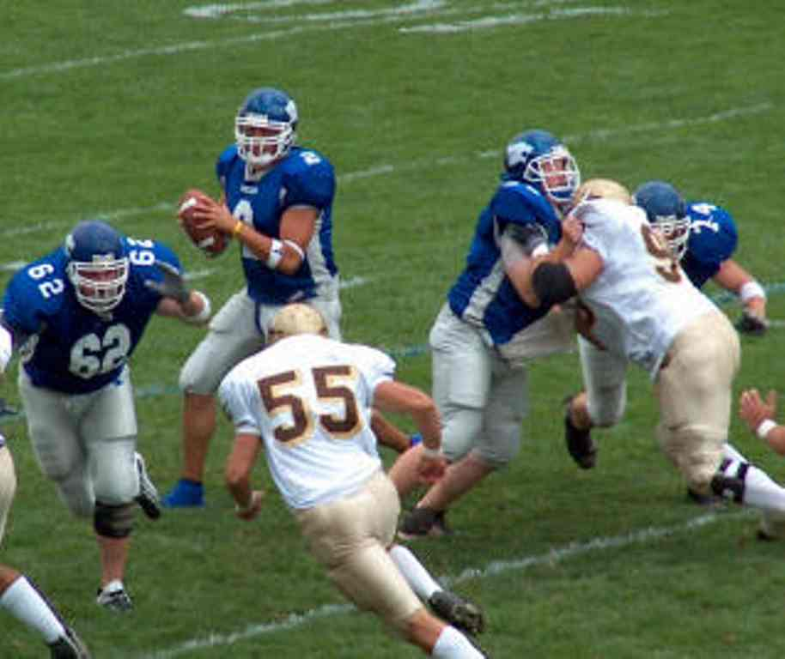


In football, as in Hess's law, only the initial and final conditions matter.
A team that gains 10 yards on a pass play but has a five-yard penalty,
has the same net gain as the team that gained only 5 yards.
10 yard pass
5 yard net gain
5 yard penalty
initial position
of ball
final position
of ball
Notes:
pg 353 Holt Chemistry Myers, Oldham, Tocci , 2004 (Holt Rinehart)

